Slide 1

Project on LPG GAS BOOKING SYSTEM
SUBMITTED BY: SUBMITTED TO:
Akshay Singla (1610991075) Ms. Jasmeet Kaur
Akhil Thakral (1610991068) Des: Assistant Professor

Slide 2
OBJECTIVE:
Objective of this software is to computerized the manual system of a Gas Agency, so that all the transactions become fast and easy. It replaces all the paper work. It works according to the need and lowers the workload of user. It provides an easy navigation menu which a layman user can also use.

Slide 3
Object Oriented Features :
Use of Classes and Objects.
Use of if–else loops and switch.
Use of Concept of Inheritance.(Multi-level Inheritance).
Use of Concept of File Handling.

Slide 4
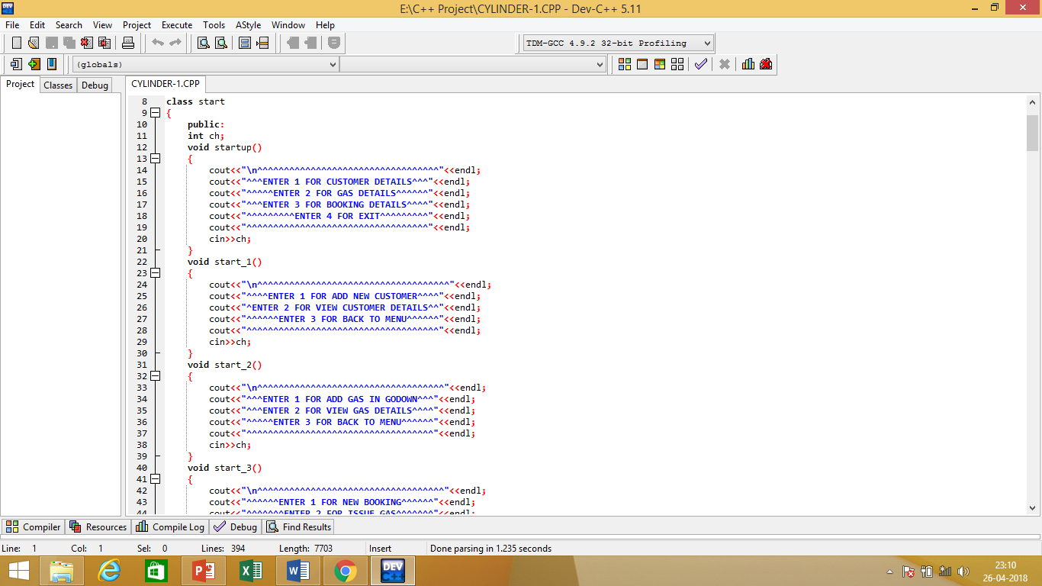
Brief Description of the project Classes:
In our project the base class is START which provide options with the help of Functions.

Slide 5
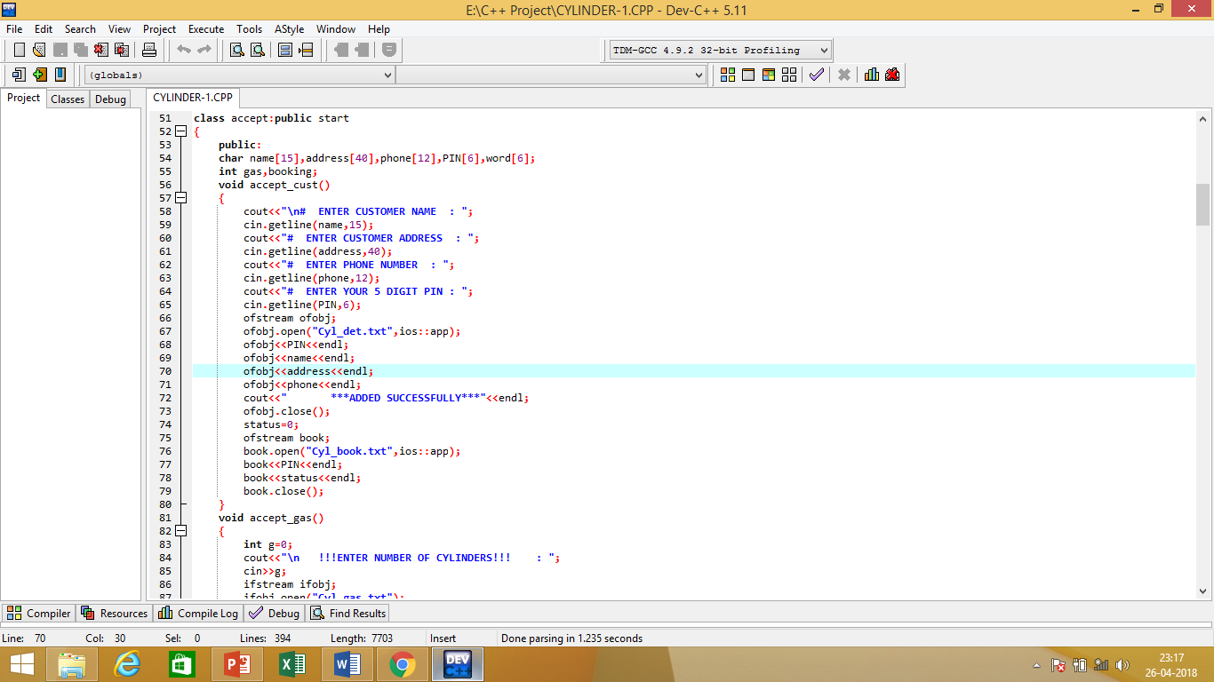
Brief Description of the project Classes:
Class ACCEPT is derived from START in public mode which takes input of Customer’s Details and Gas Details with the help of various functions.

Slide 6
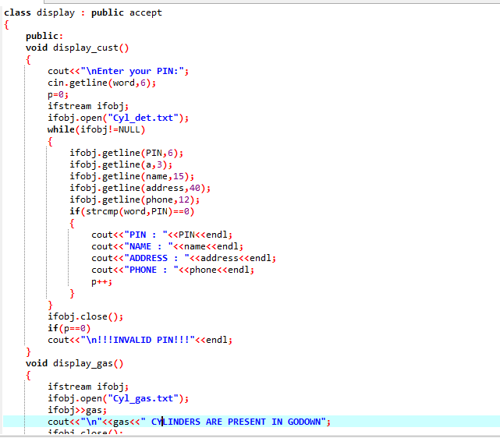
Brief Description of the project Classes:
Class DISPLAY is derived from ACCEPT in public mode which displays all details .

Slide 7
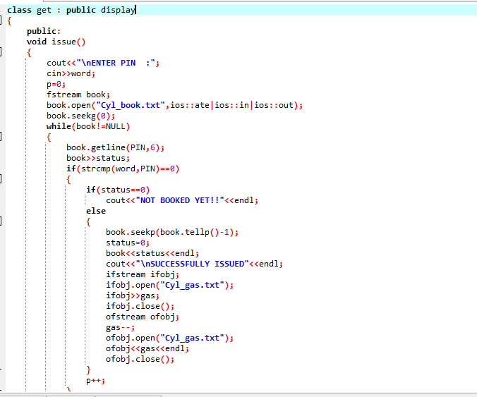
Brief Description of the project Classes:
Class GET is derived from DISPLAY in public mode check whether the gas is issued to a customer or not.

Slide 8
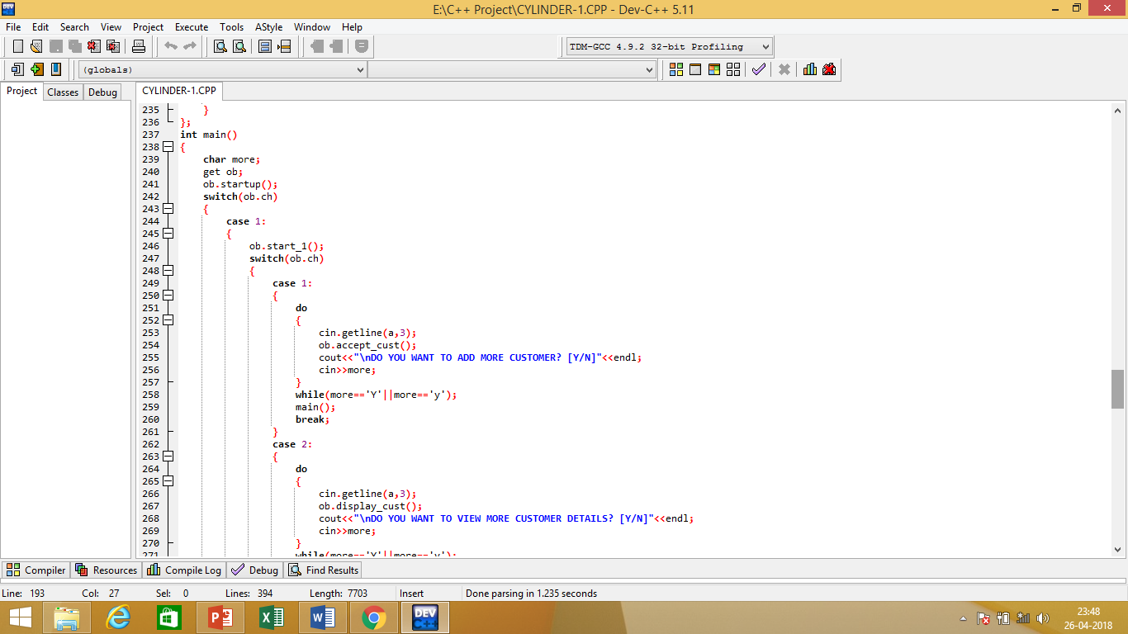
Brief Description of the project’s Main:
MAIN is created to access all these classes. It is used to add and view customers and gas in the system.

Slide 9
Thank You…

